Slide 1

AI Crime Prediction
Òkechi Brian Nyarwaba

Slide 2

Problem statement
With an increase in population there is an increase in the strain of resources this causes cases of crimes to increase.
With increased crime rates, law enforcers are required to improve their response times. this is actually difficult since people behave in a random manner.
Their response is therefore dependent on reporting time which makes them arrive at the scenes late after the damage is already done, this makes them look incompetent.

Slide 3

Proposed solution
Create an artificial intelligence that analyzes the data collected from previous crimes and uses analytic algorithms to provide visuals that will aid in enforcing the law.

Slide 4
Objectives
Create an intelligent system that analyzes crime based on the provided data to extract crime patterns using the frequency of occurrence. Considering the territorial distribution of the data.
To predict the crime rate and analyze the crime rate that is going to happen. Then, based on the conclusions, the law may choose to enforce to reduce crime.
To create a system that converts the crime data into regression problems and thus helps the detectives in solving problems.
Understanding the use of multi-linear regression to predict the graphs between different types of crimes.

Slide 5

Project Goals
Use machine learning to create an AI that predicts crime type, frequency and location based on previous data collected.

Slide 6
Requirements
Os
5gb space
Jupyter notebook
Excel
Internet connection

Slide 7
Technologies used to solve, analyze and visualize in crime predictions
Machine Learning libraries from Sci-Kit Learn
Linear Regression
Logistic Regression
Classification and Regression Trees – Decision Trees
K-Nearest Neighbors
K- means
Random Forest
Python Pandas
Matplotlib
Crime prediction requires a supervised classification ML model

Slide 8
ASSUMPTIONS
The user is already logged into the system and is secure.
The data sets are already up to date.
The data sets collected are correct and are meaningful.

Slide 9
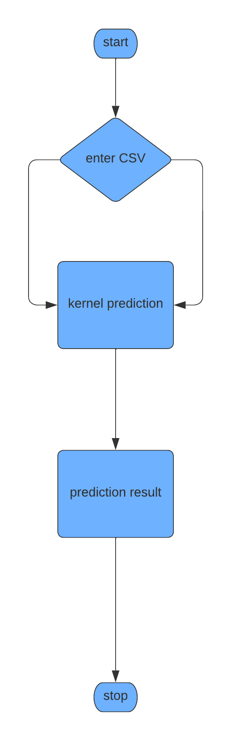
Flow chart

Slide 10
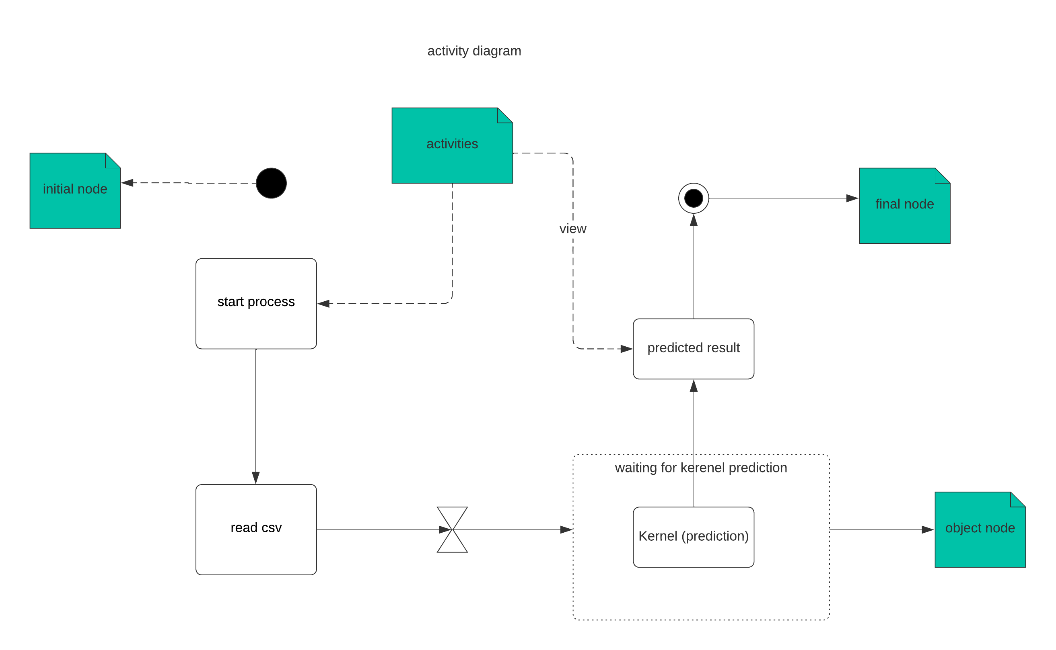
Activity diagram

Slide 11
RESULTS

Slide 12
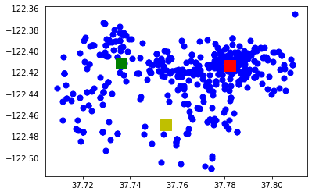
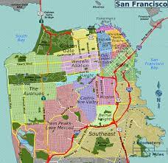

Slide 13
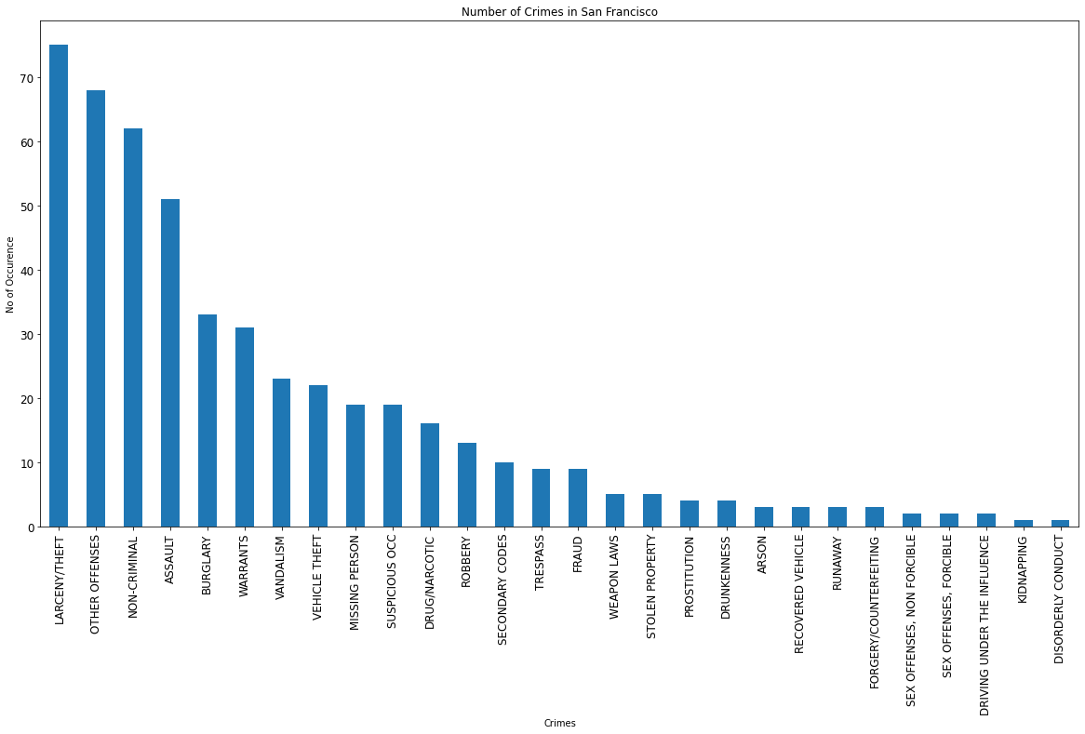

Slide 14
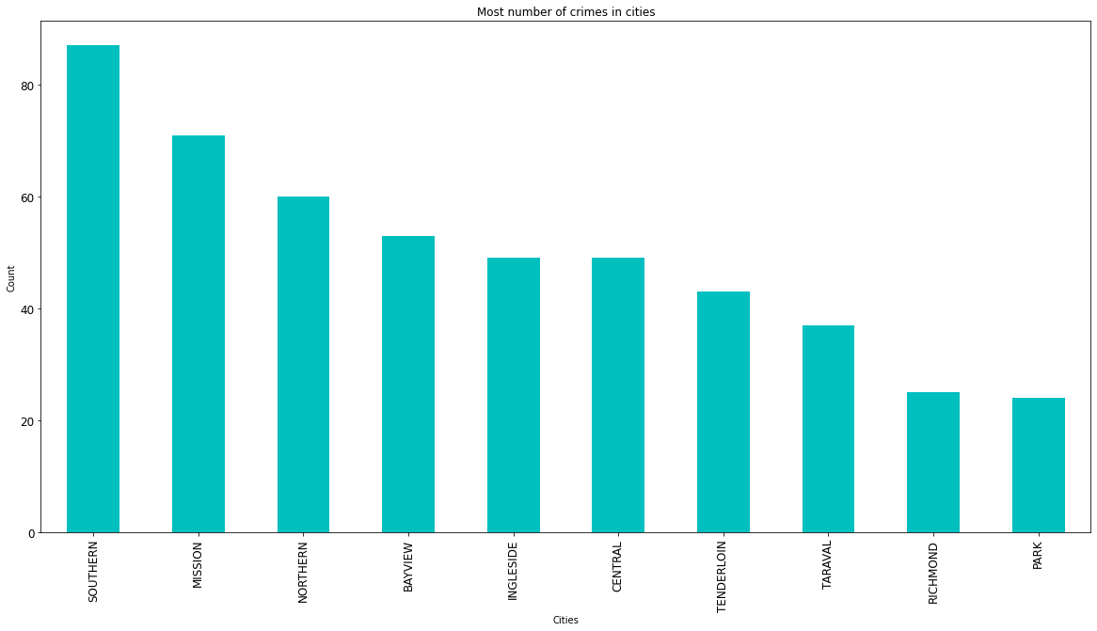

Slide 15
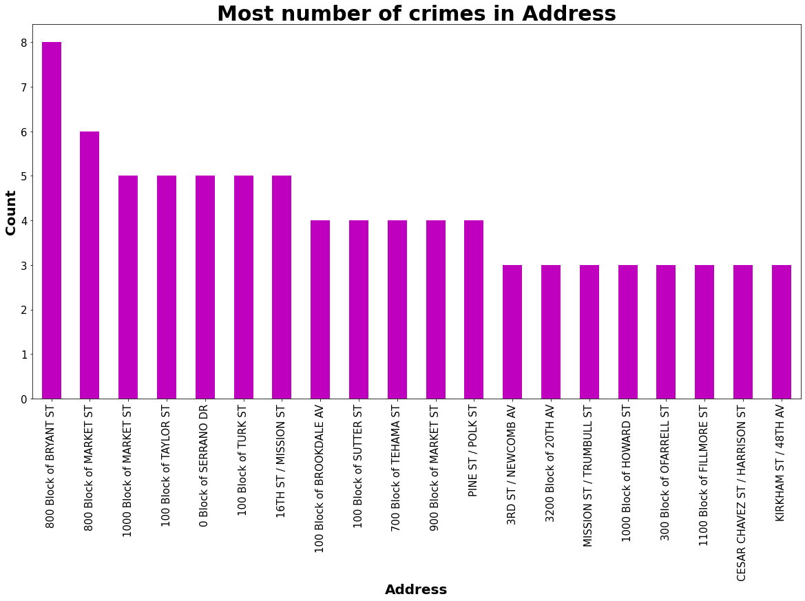

Slide 16
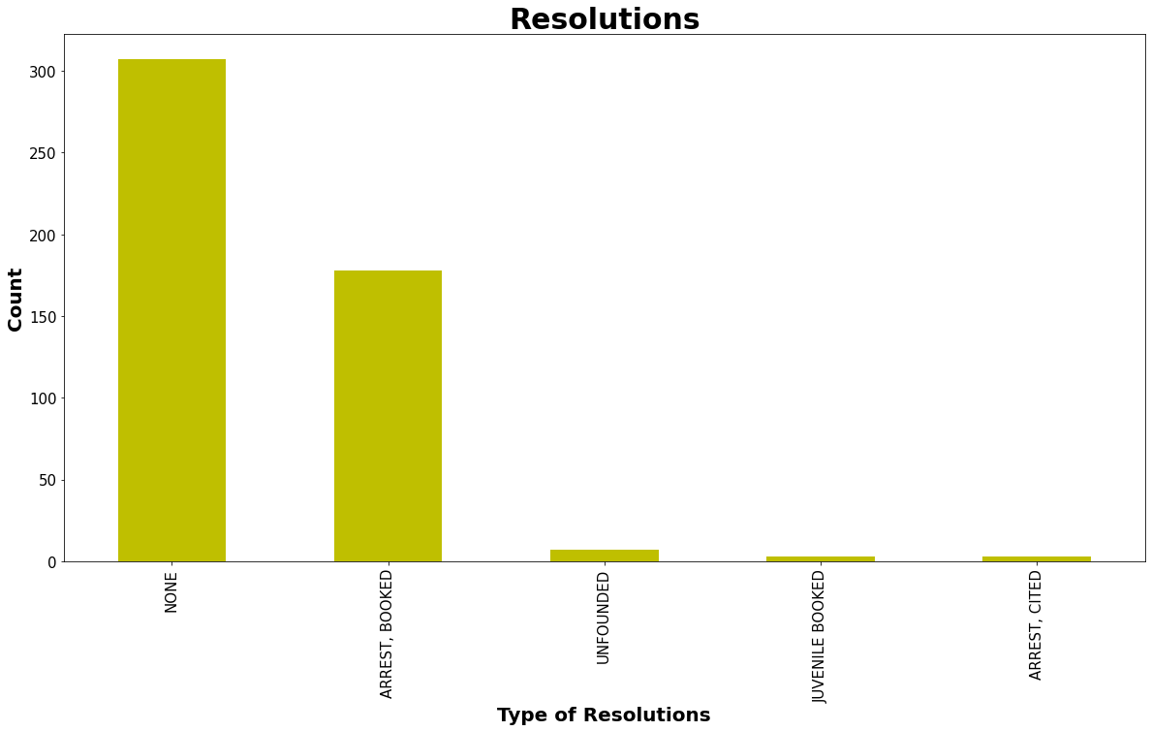

Slide 17

Data Cleaning and Preprocessing
Original Dataset = 1.9 million rows!
LESSON LEARNED: Too many distinct categories within a feature will not produce good results.
The San Francisco Crime dataset contained categories/features that were too granular (i.e., there were 129 distinct crime codes and 265 distinct premise codes). We used Excel to group “like” categories and reduce the number of codes.
Python Pandas was also used to further transform the data into what we felt would be more understandable to a machine learning model.
Time Occurred (24 hours) ⇒ 4 categories (Morning/Afternoon/Evening/Night)
Crime Codes ⇒ 129 down to 11, even further whittled down to Felony, Misdemeanor, Infraction
Premise Codes ⇒ 265 down to 24

